Slide 1
Our Mission
Create a one of a kind facility, designed to highlight new and old environmentally friendly & sustainable practices throughout.
Open the minds of vacationers and residents to new and innovative ideas of how to live lighter on this, our only planet.
Educate a captive audience on some basic small changes they could make in their day to day lives.
Notes:
Our idea is that while on vacation you have more time to reflect on your personal impact on the earth and being surrounded by unique products and interesting use of reclaimed materials you may be more open to changing some small practice in your day to day life.

Slide 2
Our Facilities
We have a total of 17 buildings on our property, each unique to its environment.
The Leap of Faith
The Phoenix
The Pavilion
14 ‘Waldens’

Slide 3
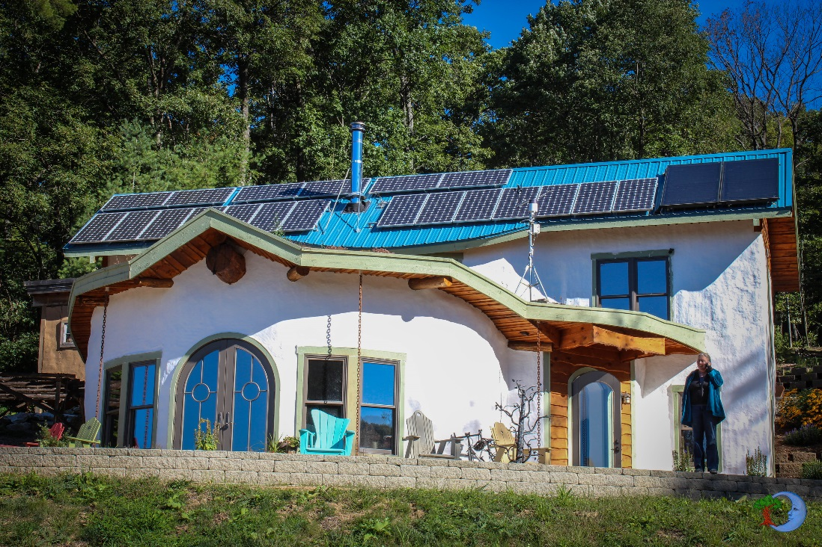
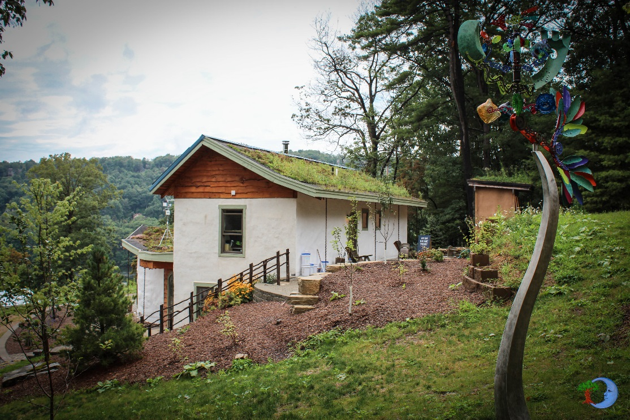
The Leap of Faith – Totally Unique
Aptly named The Leap of Faith, which
was required to even break ground on
this project, this building packs the most
green punch 1700 sq/ft can deliver.
Operating as our Office and “front-desk”
This building is a Living, Breathing monument to eco-friendly construction practices and just a simple tour open minds to all sorts of possibilities.

Slide 4
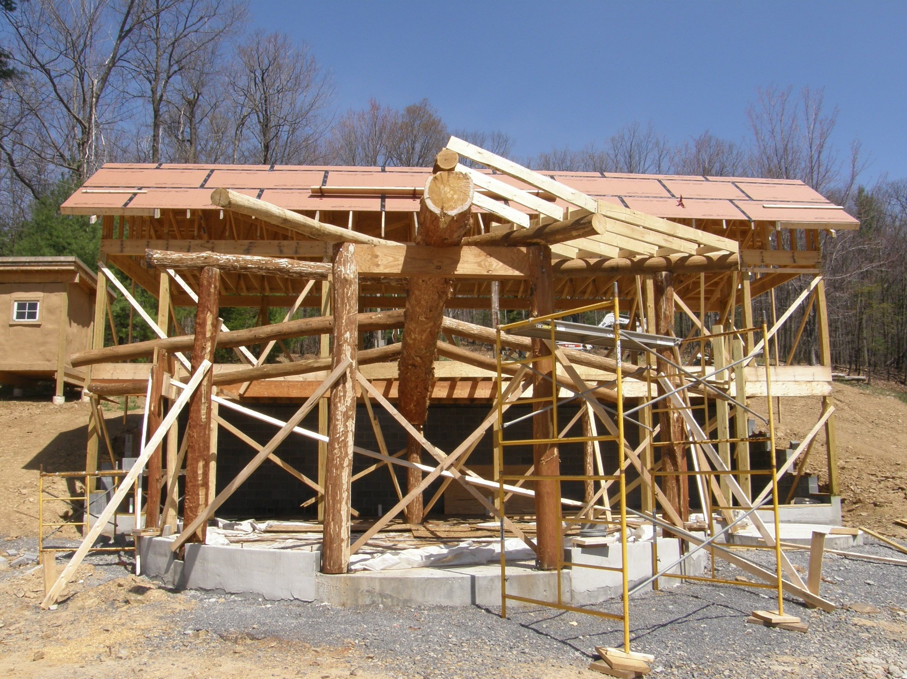
The Leap is a combination of pole building and timber frame construction, allowing the space between supports to be filled with straw instead of classically framed walls.

Slide 5
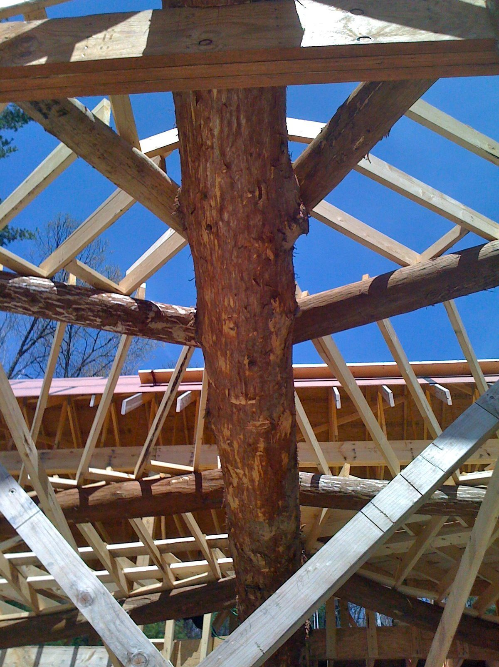
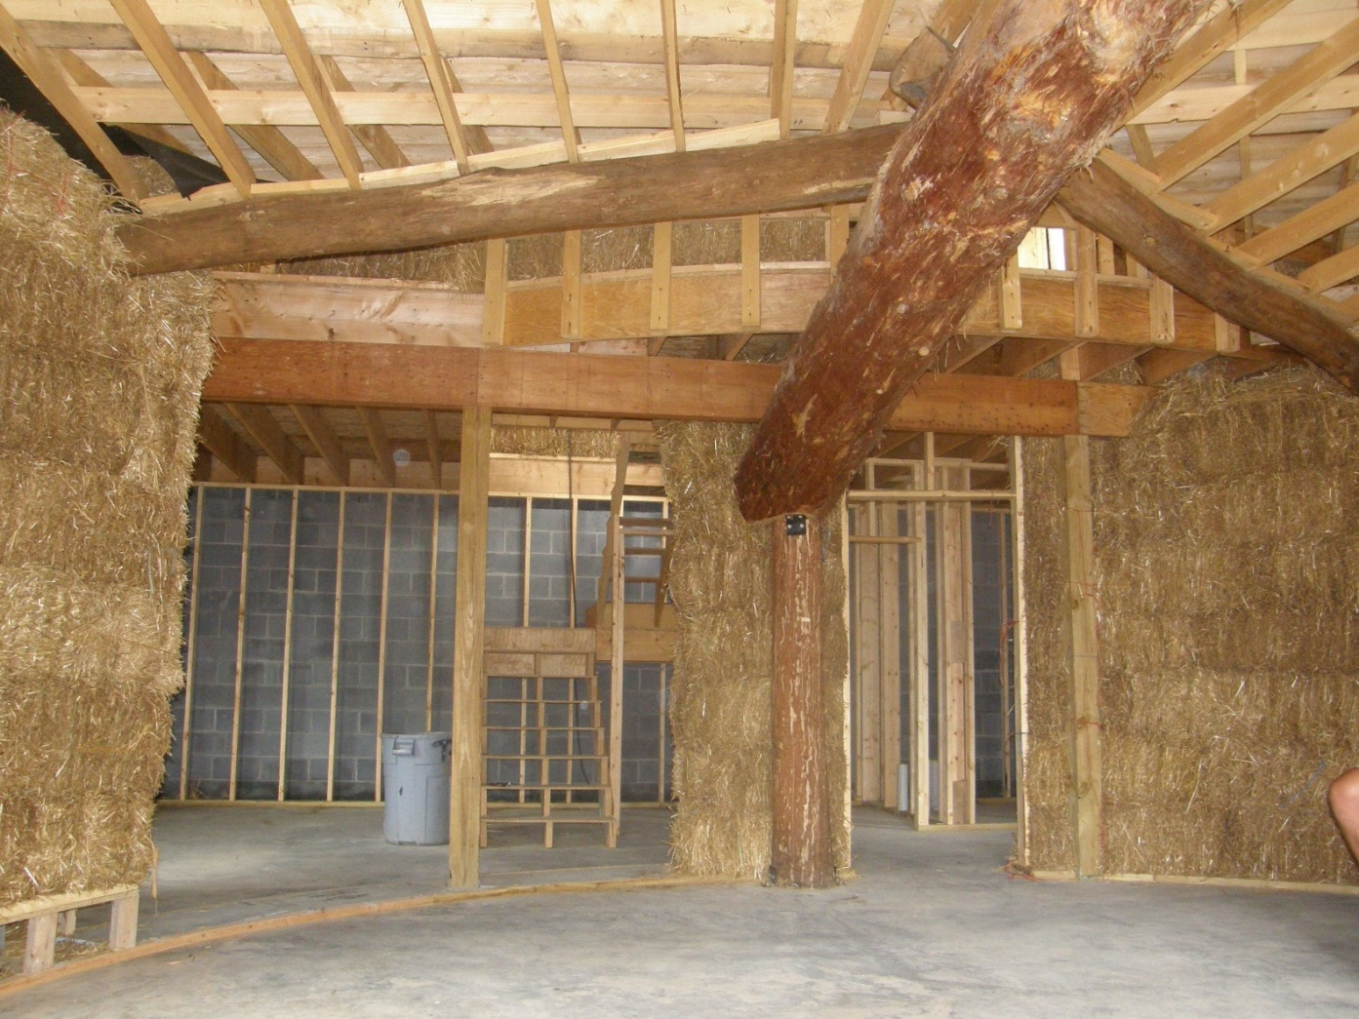
All of the logs were harvested directly from the job site, less the main beam, which was locally sourced. Each was hand shaved and set ‘green’ requiring no kiln drying.
Straw bale and soy-foam insulation

Slide 6
Insulation Types
R-value - Insulation is rated in terms of thermal resistance, called R-value, which indicates the resistance to heat flow. The higher the R-value, the greater the insulating effectiveness. The R-value of thermal insulation depends on the type of material, its thickness, and its density. In calculating the R-value of a multi-layered installation, the R-values of the individual layers are added.
Walls are Straw Bale which is rated at r-40+ because they do not rate above r-40
Soy foam is rated at r-38 - function of thickness – i.e. 1 inch = r6.5 so to get r-38 need 6” depth
Reclaimed denim in attic is two layers of r-19 = r-38
Living Roof – functions much better to reduce summer heating but does have a small effect on retaining heat in winter – no real r-value associated with it (great possible lesson plan)

Slide 7
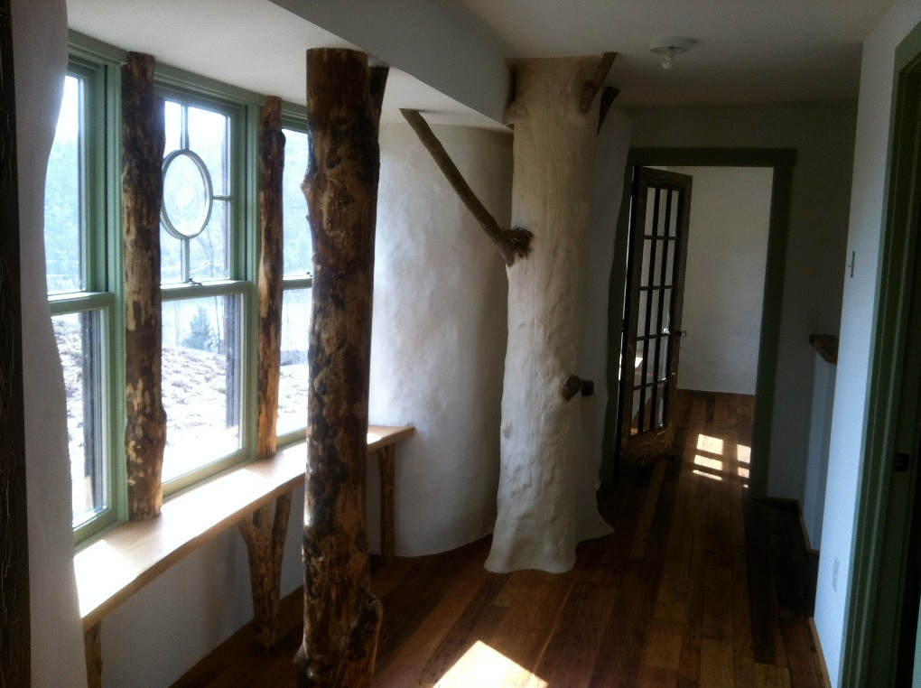
The Straw Bale Walls are coated with a lime plaster
Lime Plaster – The lime plaster that coats the Leap’s walls is a technique as old as time. Archeological digs dating back as far as 7200 BCE in modern day Jordan find lime plaster used as coatings for interior walls. The material is simple to make, it’s a mix of agricultural hydrated lime, sand, and water. Getting the mix just right is important to create a substance that is spreadable and strong enough to hold on to the straw surface. The mix can be spread by hand onto the surface or with specialized sprayers. Layer by layer it is sprayed or spread on the exterior and interior walls, usually 3 or 4 layers thick, until there is a solid surface coating all the walls. It takes a few days for each layer to dry and set up, but once it does it is very strong and quite appealing to the eye.
Notes:
The finished product has some very unique characteristics in that it is air permeable and water tight. The lime is activated when water hits it and as it drys rebonds its molecules together, allowing for easy repairs and painting with lime paints.

Slide 8
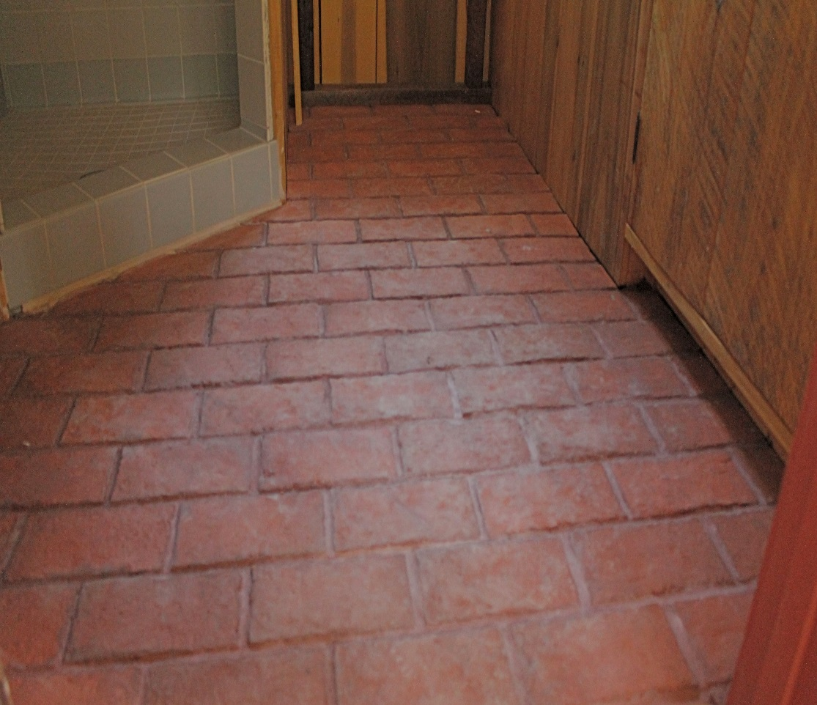
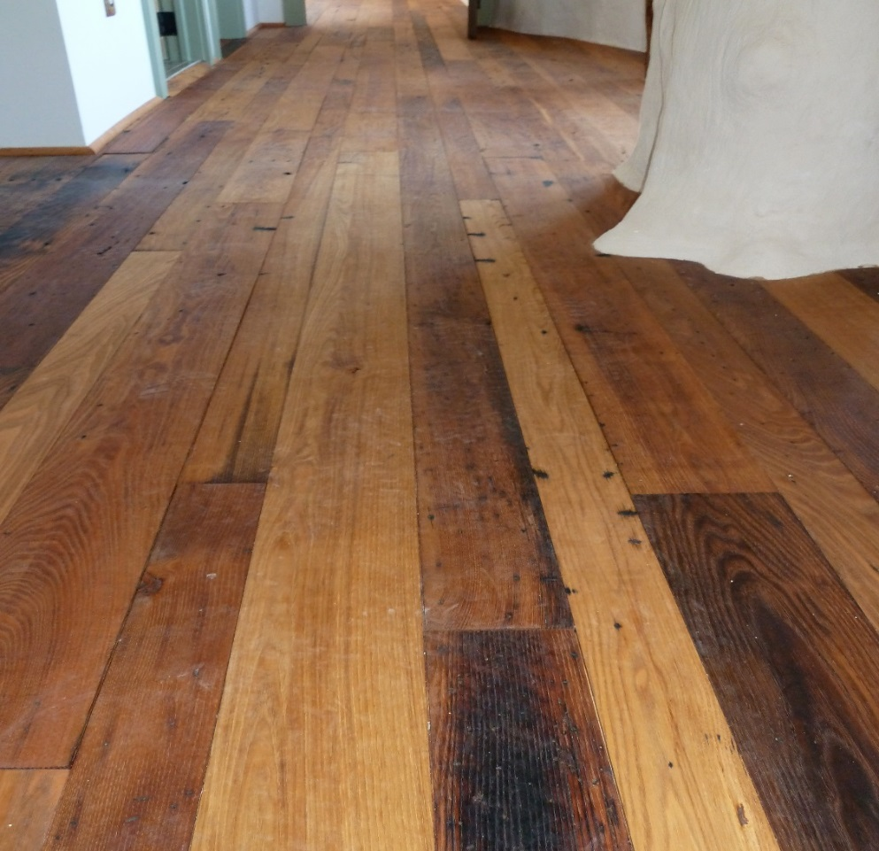
Reclaimed and Sustainable interior finishes
Throughout the project we worked to operate within the three R’s
Reclaimed, Recycled or Recyclable or Socially Sustainable products.
The Leap, Phoenix and cabins are filled with reclaimed lumber, ecofriendly and sustainably sourced products.

Slide 9
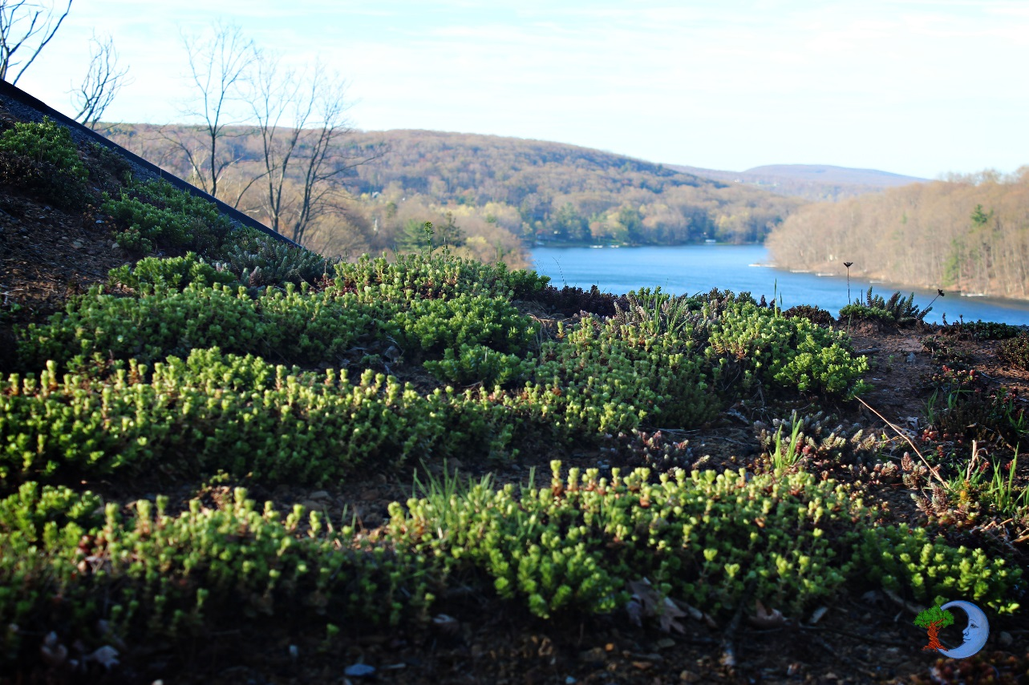
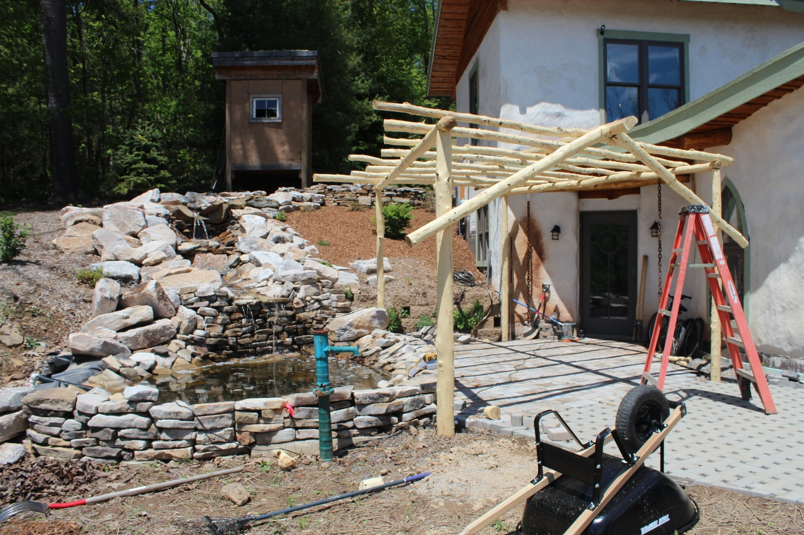
Sustainable Landscaping & Storm Water Management
The landscaping and storm water management features of the Leap fit nicely with its unique character.
Using the living roof, and permeable paver patios we were able to eliminate the need for unsightly storm water swales. The water run off from the roof and patios are piped in to an underground cistern that is tied into our pond.

Slide 10
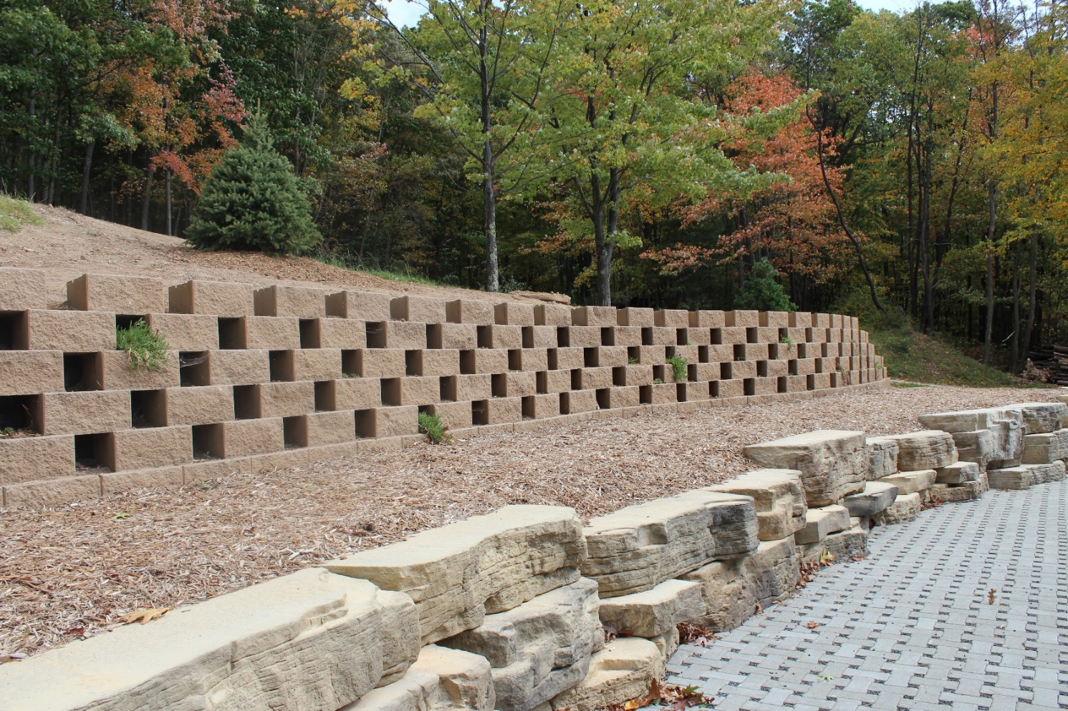
Sustainable Landscaping & Storm Water Management
Even our retaining walls are one of a kind. The living walls require much less raw material to hold back the same amount of earth and create a beautiful vertical landscape. The large rocks you see are actually made from mostly recycled materials.

Slide 11
Solar PV and Solar Thermal
Our solar PV system is comprised of 20 200W panels equating to a 4KW system.
The leap is on net metering, which means it is grid tied and we feed electricity back into the grid when we are generating it and get credit toward our usage.
Through out the sunny months, we generate enough to be a net zero using building for the year. – we are slowly consuming more energy now that we are doing more laundry and such so we’ll see how well we do when we’re fully open for business.
The solar thermal system heats our domestic hot water. We have an inline electric back up heater for those cloudy days.
Great opportunity for a lesson plan here.

Slide 12
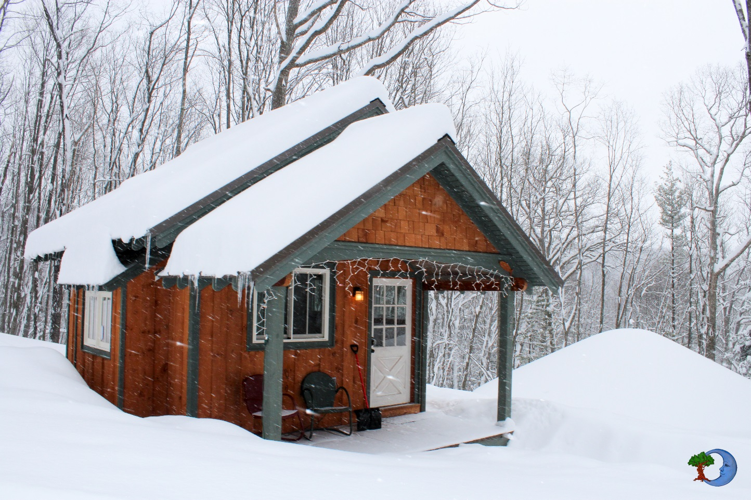
The Waldens … Thoreauvian Living
Our cabins are not just named after the classic novel, they are inspired by it.
Each has been carefully
designed by Bill Thomas of
Hobbitat.
Each designed to sleep 2-4
comfortably they all are unique
in materials and layout.
Construction techniques throughout
use the three R’s and the small
efficient designs waste little
material and very little energy.

Slide 13
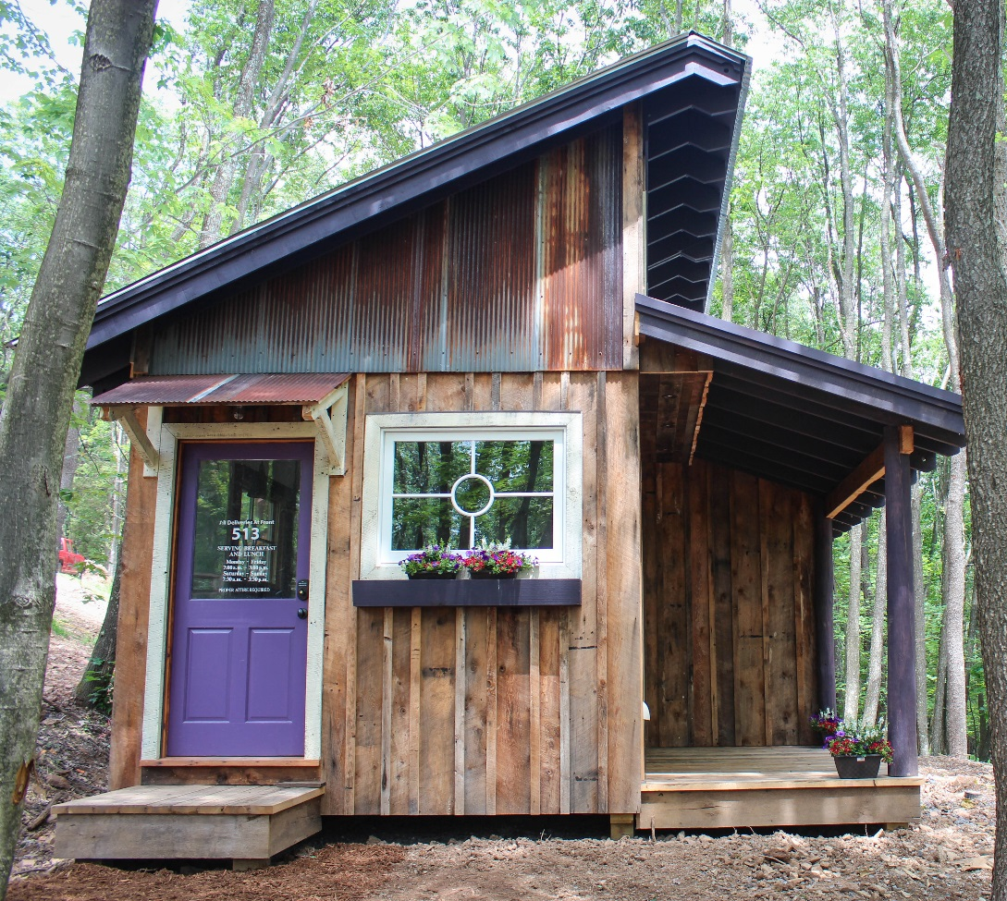
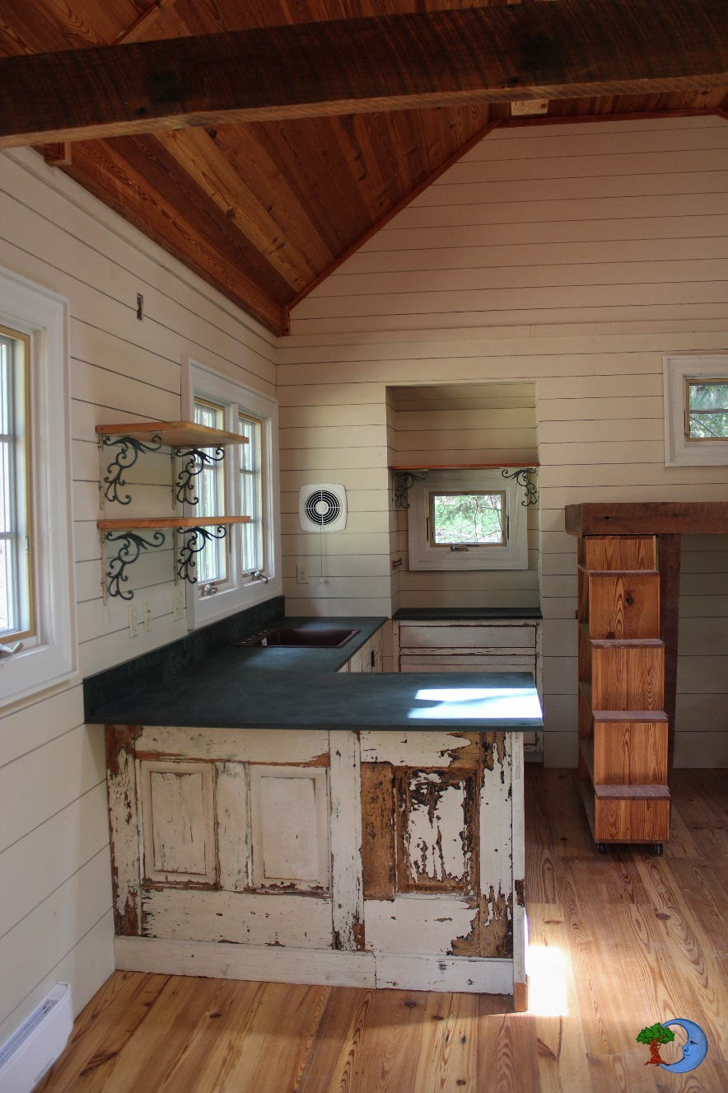
Reclaimed and Sustainable finishes

Slide 14
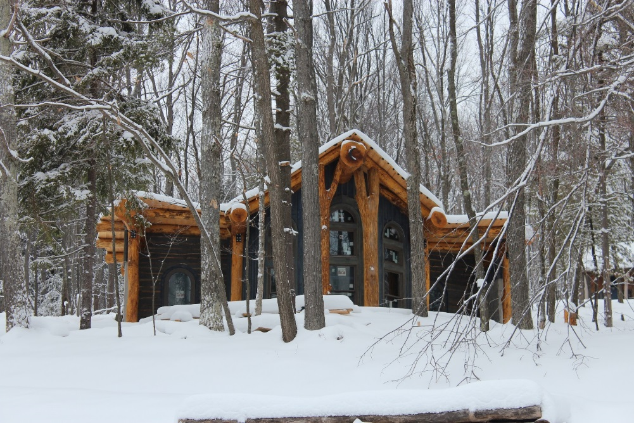
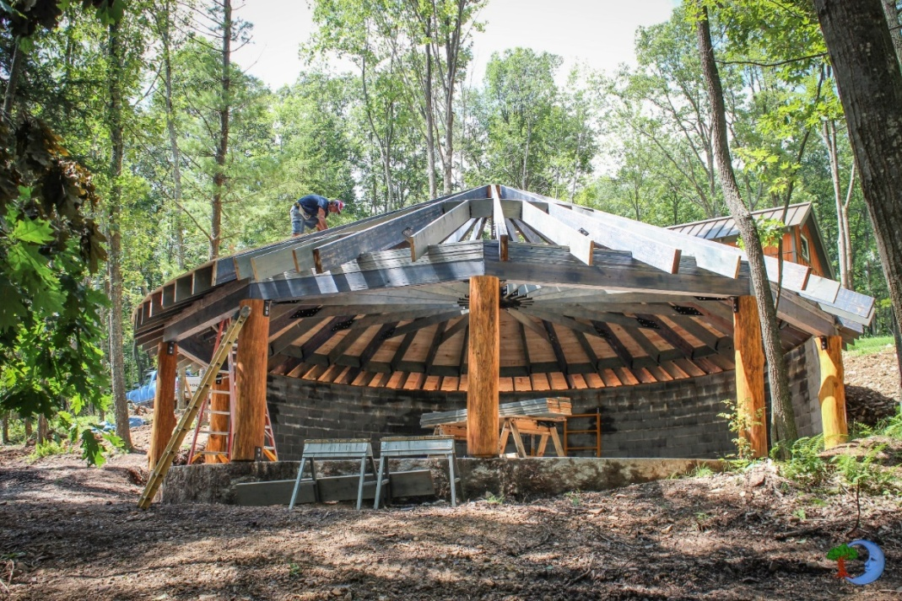
The Phoenix & Pavilion
The Phoenix, named for rising
from the ashes of a bad builder
relationship, is as unique as the
rest of the site and will function
as a meeting space and
community kitchen. Connected
is another one-off pavilion
intended as a gathering space
for the community.
Our pavilion is also constructed using
some oak logs from the site, and in classic
style we went above and beyond in the design.

Slide 15
Opportunities for Teachers
My ideas
Tours
Design lesson plans around a trip to our facility
Bryan Barnard will design a lesson plan with/for you
Use us as a place to meet your eco-literacy requirements
You tell me …

